Slide 1
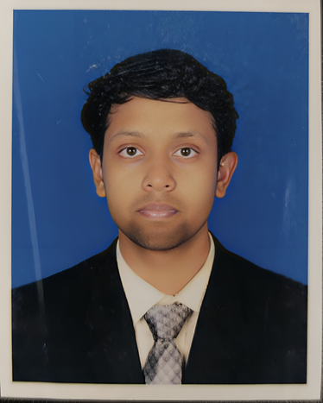
ARNAB CHAKRABORTY
Address:
Phone:
Green City, Mohammadpur , Dhaka, Bangladesh
01648003624
Email:
LinkedIn:
arnabchakrabarty219@gmail.com
Arnab Chakraborty
EDUCATION
HARD SKILL
Bachelor Of Business Administration ( B.B.A )
June 2022 - Present
  Microsoft Office
  META Suite
  Adobe Illustrator
  Adobe Software
  Wordpress Website
  Power BI
East West University
Major: Marketing
Result: CGPA 3.33 out of 4.00
Higher Secondary Certificate ( HSC )
2018 - 2021
Sonar Bangla College
SOFT SKILL
Group: Business Studies
Result: GPA 4.25 out of 5.00
  Problem Solving
  Public Speaking
  Operation & Strategy
  Teamwork
  Emotional Intelligence (EQ)
  Content & Publication
  Customer Service
Secondary School Certificate ( SSC )
2016 - 2018
Sonar Bangla College
Group: Business Studies
Result: GPA 4.85 out of 5.00
WORK EXPERIENCE
Marketing Head
December 2025 - Present
TRAININGS
GC Sports & Kids Zone
East west University Business Club
  Led overall marketing strategy and business growth planning.
  Increased monthly restaurant sales from 18K to 73K through customer behavior analysis, targeted offers, and experience-based marketing initiatives
  Introduced data-driven decision-making.
Exceed Excel 2024 Training Program
Duration:
March 22 - march 23, 2024
East west University IFC
Road2Fin 2024 - Training Program
Duration:
Nov 27 - Nov 29, 2024
Marketing & Operation Executive
October 2024 - December 2025
East west University IFC
GC Sports & Kids Zone
Career Toolkit 2023 - Training Program
  Develop and implement marketing strategies to increase brand visibility and customer engagement.
  Execute digital marketing campaigns.
  Handle CRM activities to enhance customer relations.
Duration:
Nov 18 - Dec 8, 2023
East west University IFC
NEXTOR Stock Market - Training Program
Duration:
Feb 28 - May 5, 2024
CLUBBING EXPERIENCE
ACHIVEMENTS
East West University Investment and Finance Club
EWUIFC presents CATCHCASE
Sub-Executive, Content Writing Department
Sept 2024 - Present
Winner
Senior General Member
June 2023 - Sept 2024
Duration:
May 8 - May 15, 2023
General Member
Oct 2022 - June 2023
YSSE presents Research, express & Brief your idea”
  Created compelling content for promotional materials and events.
  Assisted in organizing marketing campaigns and university events.
  Leading a vest and creative team of 100+ emerging talents
  Executed Events: Career Toolkit, Road2Fin, FinXcel, Train2Pro, CatchCase, NeXTor, The Pitchers, Corporate Visit.
Winner
Duration:
Sept 10 - Sept 14, 2024
Best Presenter Award
Provided by Professor
EXTRA-CURRICULAR ACTIVITIES
REFERANCES
  Intern at Youth School for Social Enterpreneurs ( YSSE )
  Management Trainee at ( YSSE )
  Volunteer of Sonar Bangla College Sports club ( SBCSC)
  Volunteer of East West University 24th convocation.
Reaz Hafiz
Senior Lecturer
Department of Business Administration
Email:
reazhafiz@ewubd.edu
Contact:
01614336620

